Slide 1
Architecture of Driving Games
Nathan Bonavia Zammit – 0198402L
Matteo Sammut – 0206002L

Slide 2
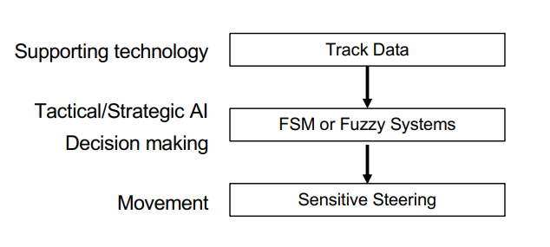
AI Architecture of Driving Games

Slide 3
AI Techniques in Driving Games
In the Driving genre of games, the main AI techniques focus on the movement of other NPCs.
The movement of said NPCs must seem realistic in their goals
  Whether that be trying to finish first in a race
  Or simply driving around in traffic to get to their destination
  This is mostly achieved through Tactical Reasoning and Route Finding which go hand in hand.

Slide 4
Driving Line
In most Racing games a driving line is set.
The driving/racing line allows the car to reach top speeds easily with usually minimal steering being required since predefined paths are used.
This is different in Driving games.
The racing line cannot always be followed due to different physics and race conditions come in to play.

Slide 5
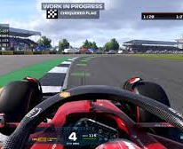
Formula 1 (Example)
In the F1 series, AI is used to do as mentioned, opposing drivers will drive along the racing line (which can be made visible to the main player aswell), and try to follow an invisible target and overtake other drivers.
The difference is that the level of AI can be adjusted.
By doing so the opposing drivers will vary in difficulty.
For Example the highest level of AI can adjust to the race conditions, physics and so forth much better than a low level AI.
Some would even say the highest level is almost as difficult as irl performances.

Slide 6
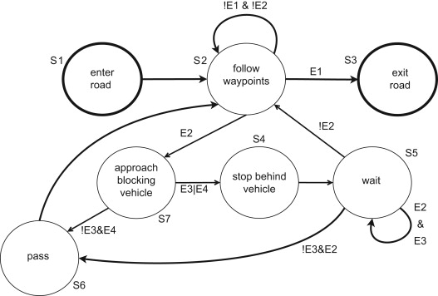
FSM
Short for Finite-State Machine
A model used to represent and control an execution flow
The brains' of a bot.
Works by having a set of states where each state has a purpose.
Could be a function or a method.
Skipping to states is not allowed meaning it cant jump from A to C if A connects to B and B connects to C.

Slide 7
Chase the rabbit
The Rabbit being referred to is an invisible target which is moved along the racing line via the direct position update method.
Any AI drivers are programmed to simply follow said rabbit.
Since the rabbit is always in front, the rabbit starts to turn corners first which therefore makes sure that the AI Drivers steer at the right point
Cars automatically begin steering well before the corner, however if corners are severe the physics of the game makes the back of the car slip out more often than not
This makes the game feel more natural as mentioned before.

Slide 8
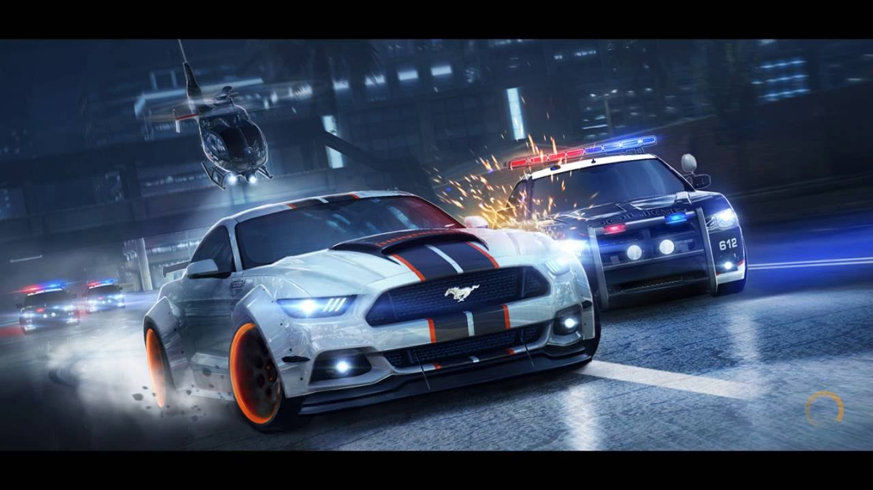
Need for Speed (Example)
The need for speed games are often seen as the go to generic racing games.
The player plays against AI drivers who vary on difficultly based on the level and track and upgrades on the car.
These cars are often generated through the use of AI and can differ based on the tracks and type of level giving the AI more of an advantage.

